Slide 1


Slide 2

Hardware
Arduino Uno

Slide 3
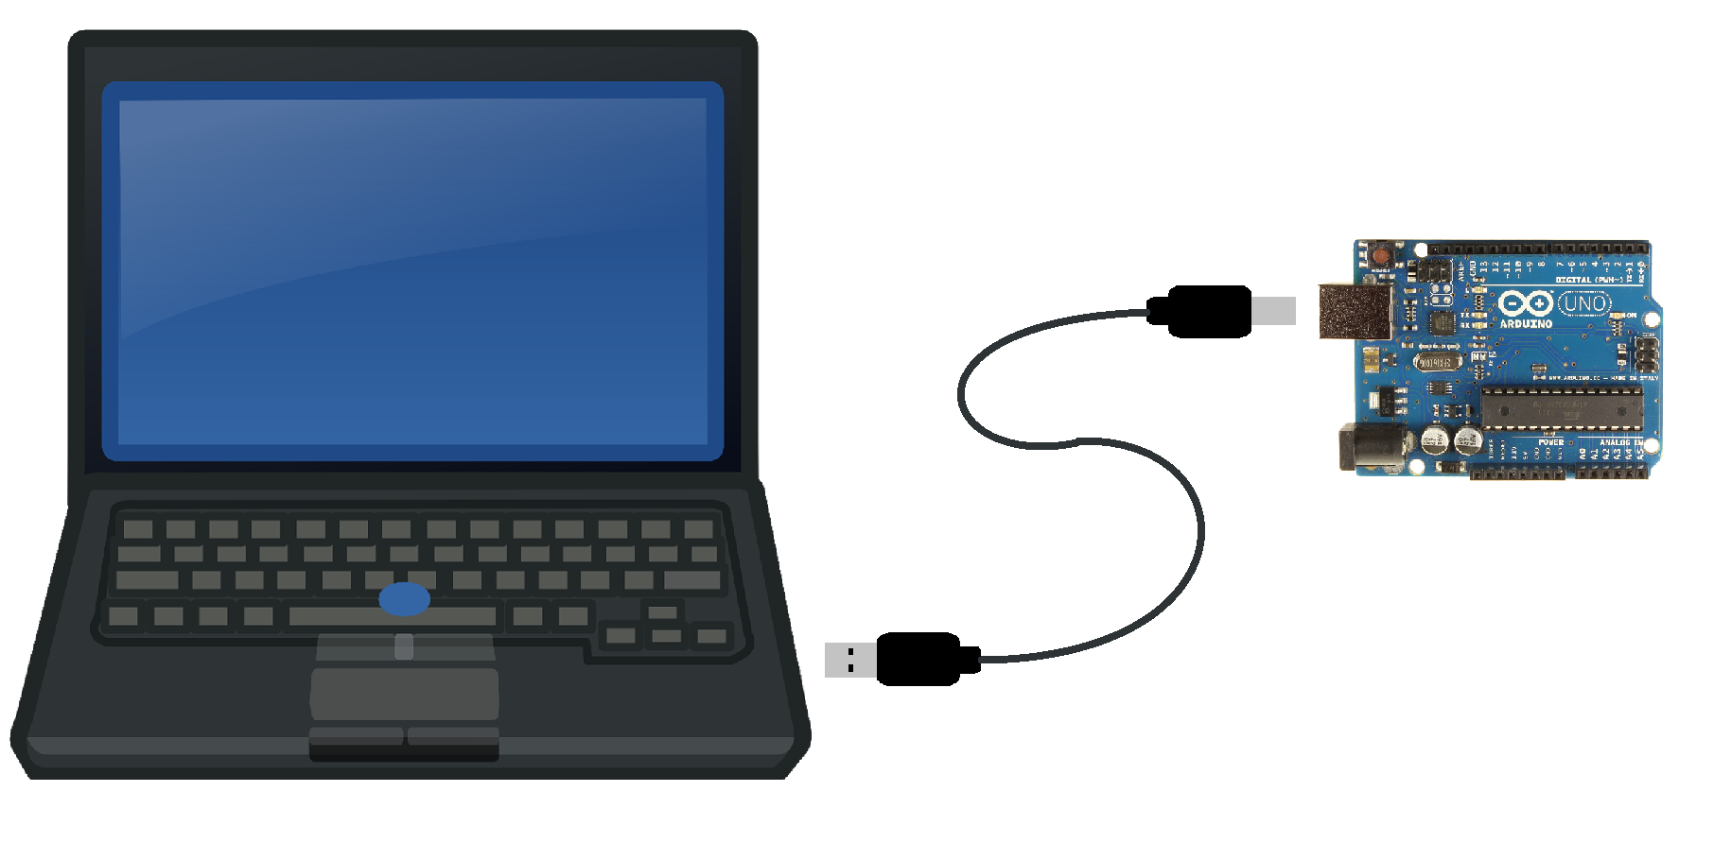
Powering & Programming the Arduino

Slide 4
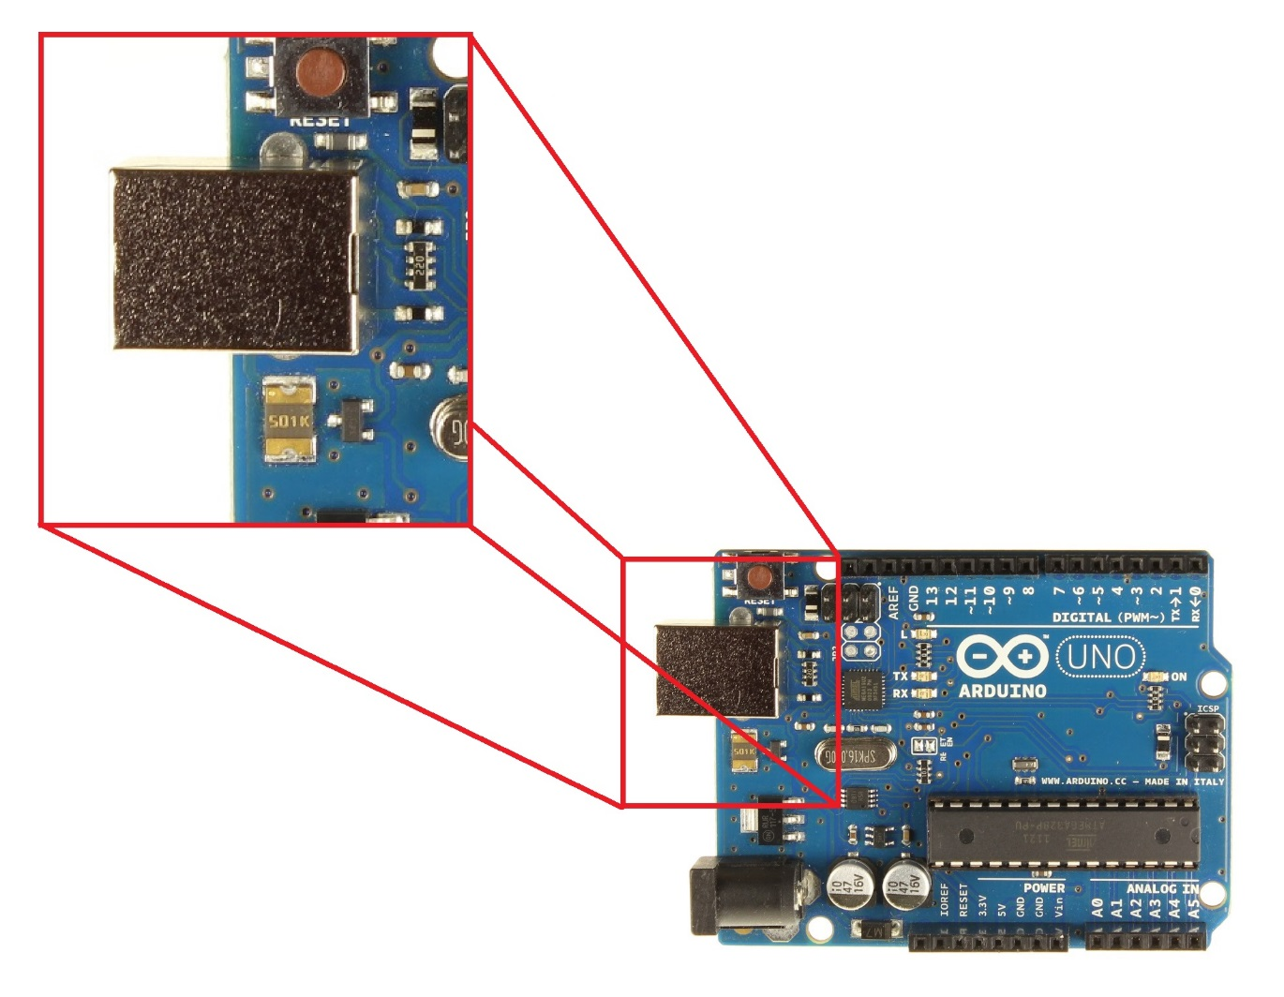
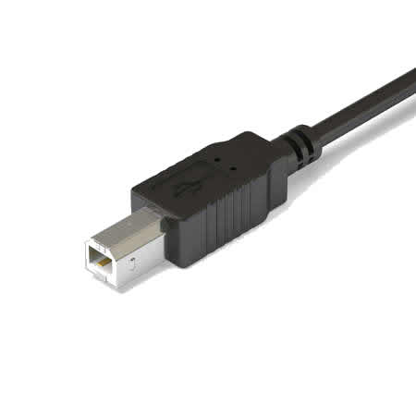
USB-Type B Port

Slide 5
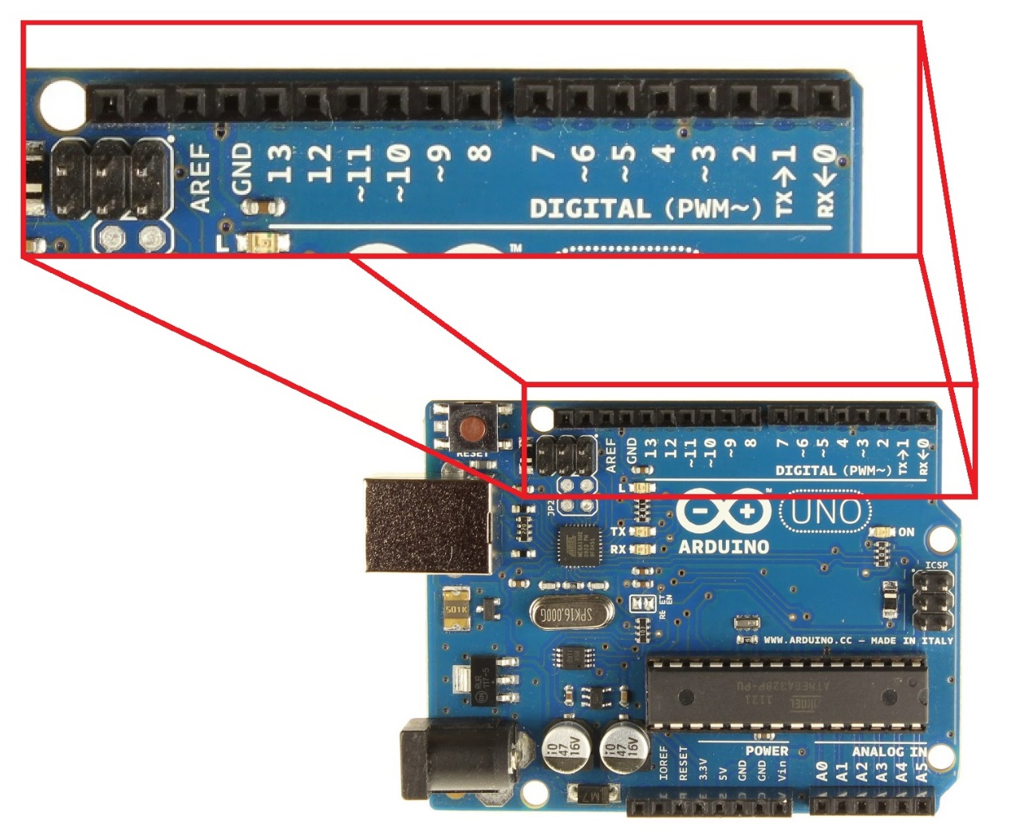

Digital Pins
Digital Signal
1 or 0
HIGH or LOW
5V or 0V
Example: A Light Switch

Slide 6
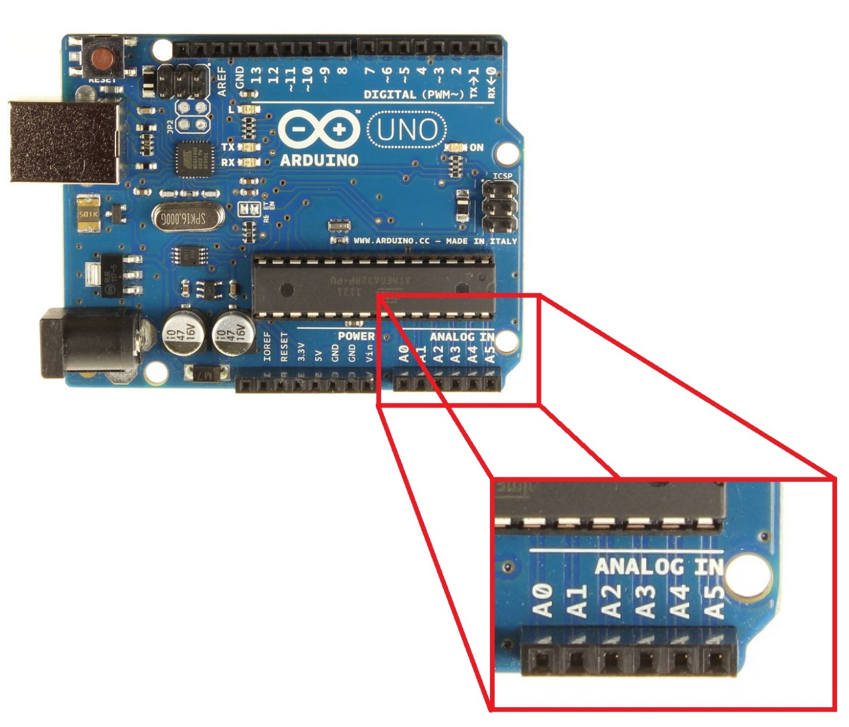

Analog Pins
Analog Signal
Varies
0V to 5V
Example: A Volume Knob

Slide 7
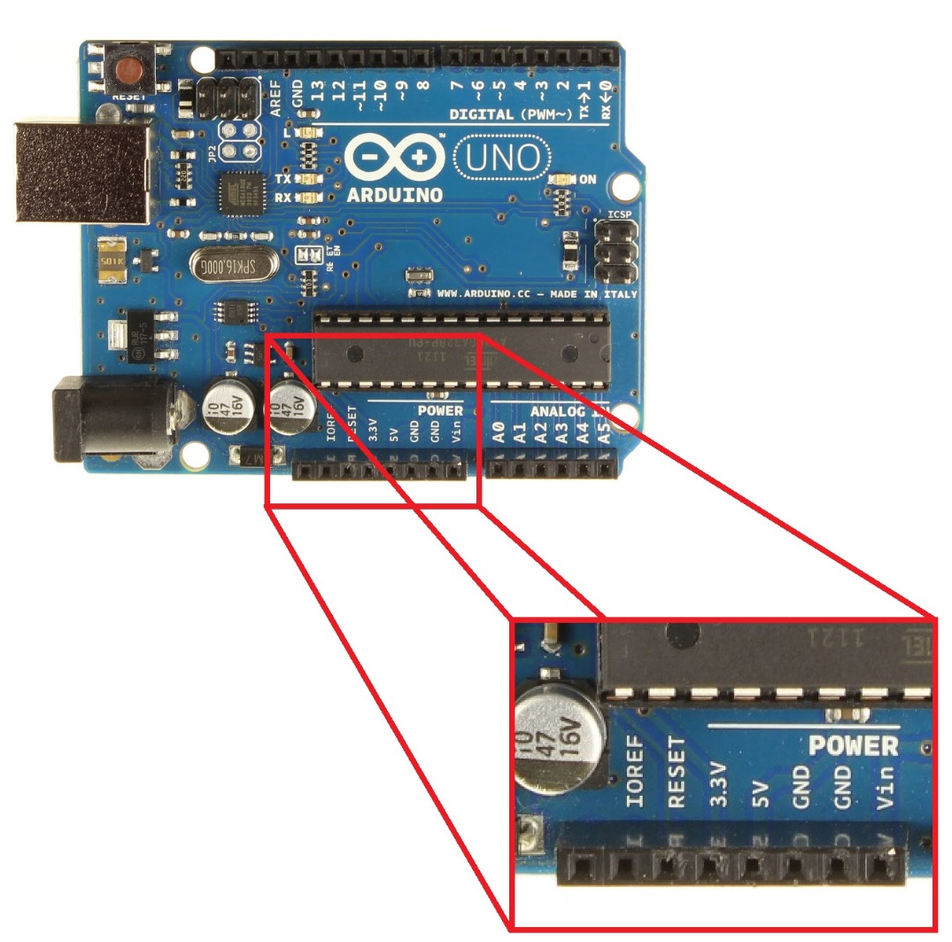
Power Pins
Provide and Receive
5V or 3.3V
Vin = Receive Power
GND = Ground
GND Rules!!
Arduino must always be grounded to any circuit that it is connected to

Slide 8
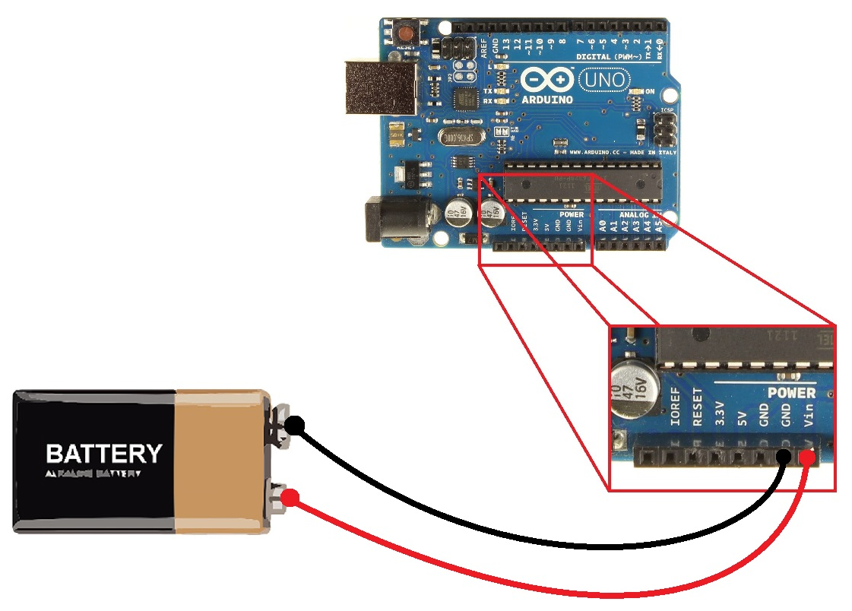
Powering the Arduino
Input Voltage
7-12 Volts Recommended
WARNING!!
Do not connect backwards

Slide 9
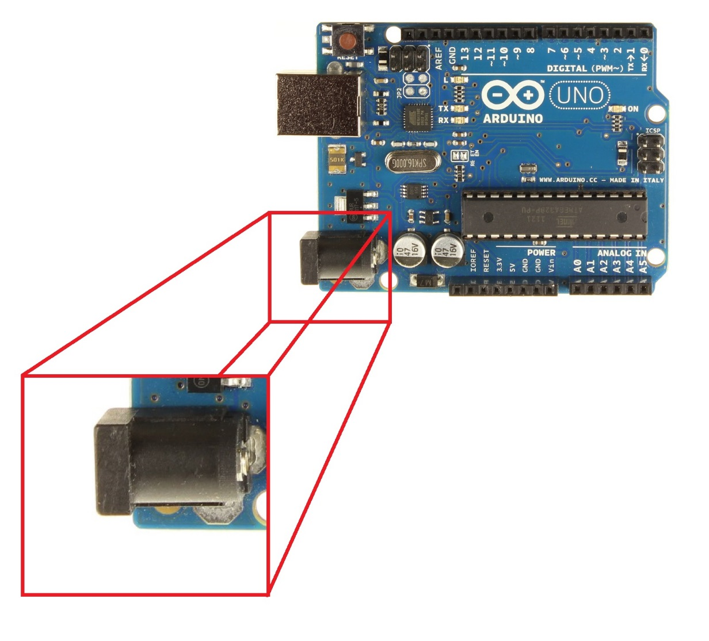
Powering the Arduino
Input Power
Barrel Jack

Slide 10
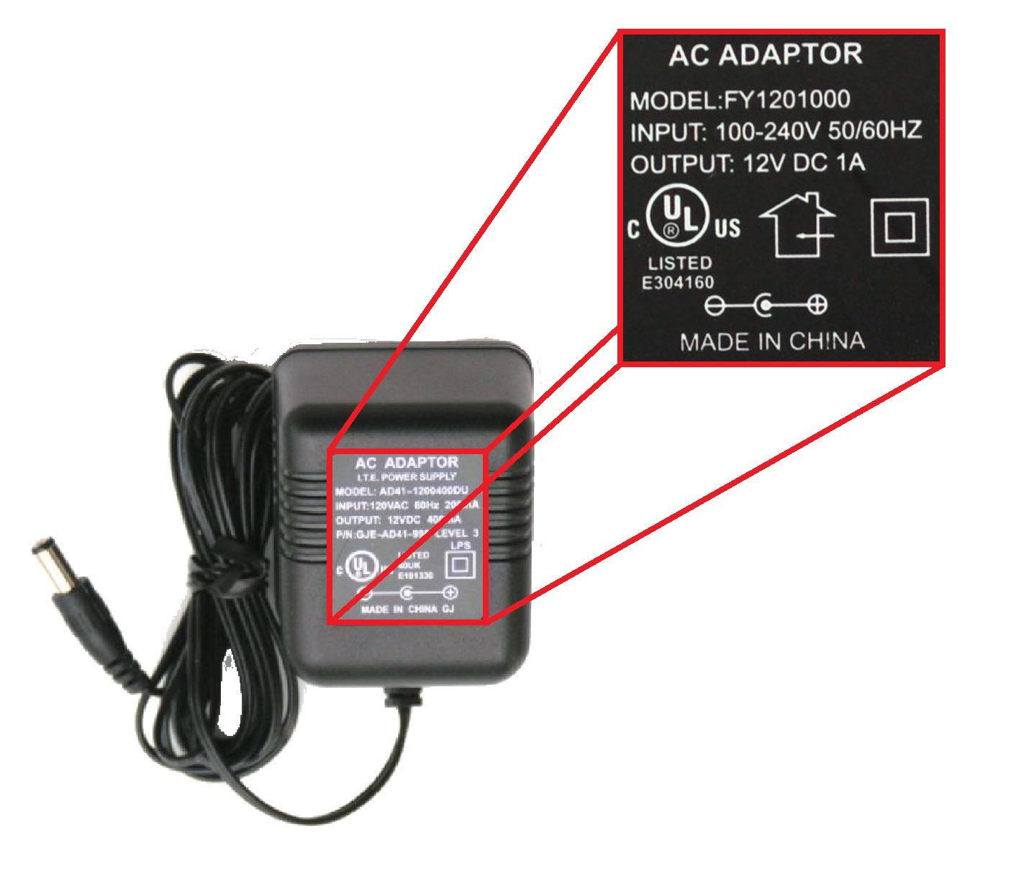
Power Supply
AC Adaptor
7-12 Volts Recommended
At least 250 mAmp
WARNING!!
Plug must be center positive!!

Slide 11
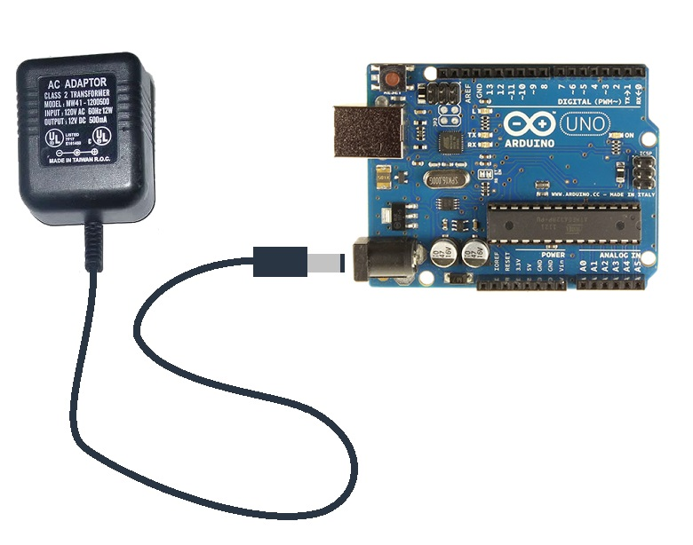
Powering the Arduino

Slide 12
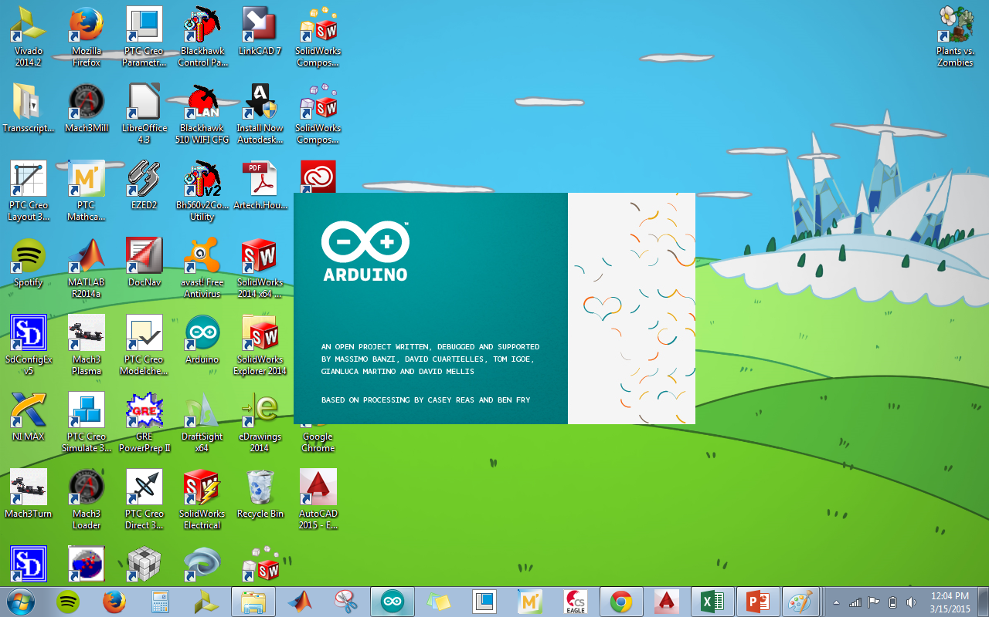
Software
Arduino IDE

Slide 13
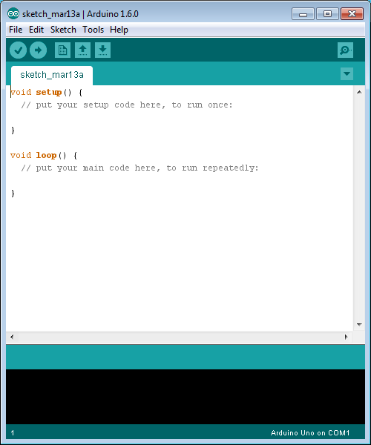

Slide 14
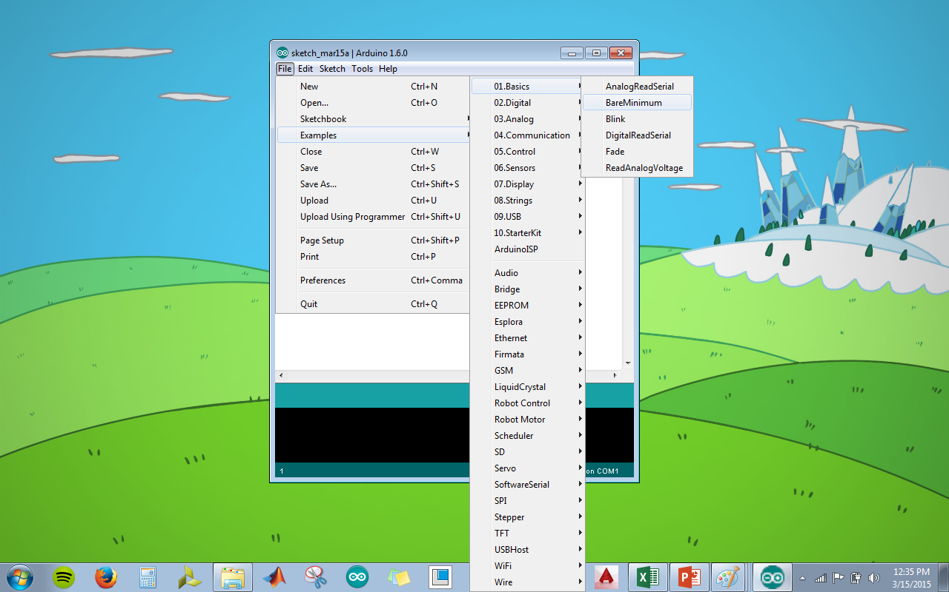
File>Examples>01.Basics>BareMinimum

Slide 15
void setup () & void loop ()
Case Sensitive

Slide 16
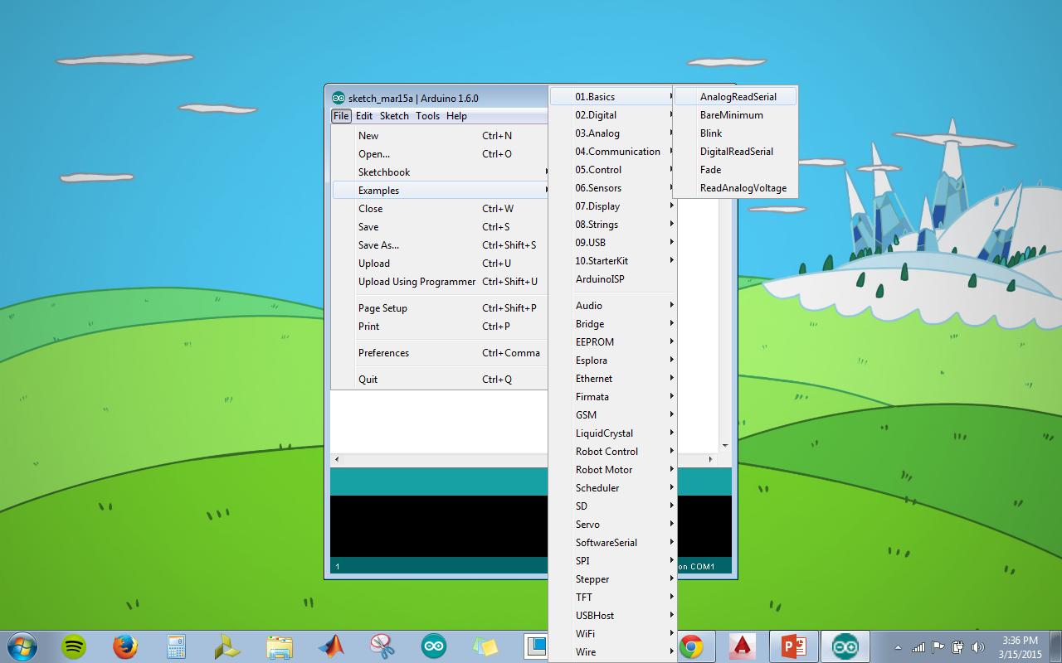
File>Examples>01.Basics>AnalogReadSerial

Slide 17
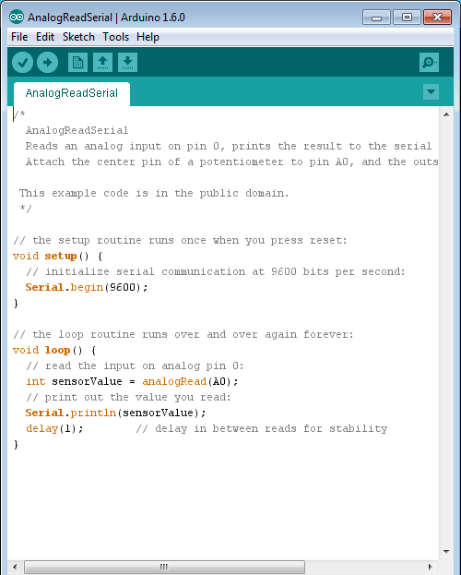

Slide 18

Resources

Slide 19
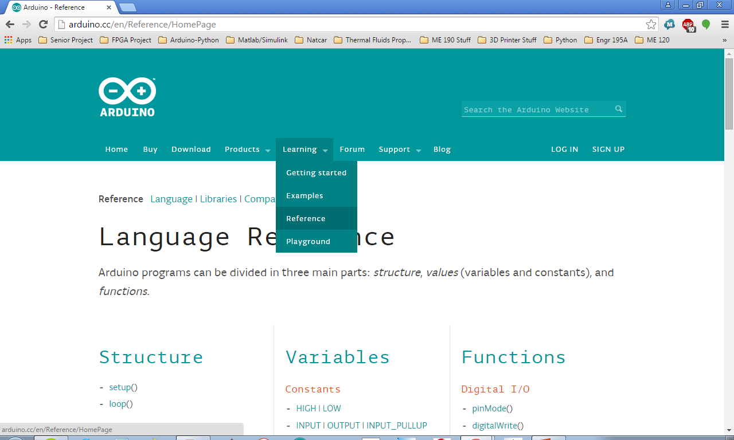
Learning>Reference

Slide 20
